Slide 1
C# Bootcamp
{ Module 2: Selection Statements, Repetition Statements, Scoping}
Date will go here

Slide 2
Module Objectives
Learn about conditional expressions that return Boolean results and those that use the bool data type
Examine equality, relational, and logical operators used with conditional expressions
Write if selection type statements to include one-way, two-way, and nested forms
Learn about and write switch statements
Learn why programs use loops
Write counter-, state-, and sentinel-controlled while loops
Examine the conditional expressions that make up a for loop
Be introduced to the foreach looping structure
Compare the do…while looping structure with the predefined forms of loops
Write loops nested inside other loops
Learn about keywords that can be used for unconditional transfer of control

Slide 3
Basic Programming Constructs

Slide 4
Basic Programming Constructs
Basic Programming Constructs
Simple sequence
Selection statement
If statement
Switch
Iteration
Looping

Slide 5
Making Decisions
Introduction
Central to both selection and iteration constructs
Enables deviation from sequential path in program
Involves conditional expression
“The test”
Produces Boolean result

Slide 6
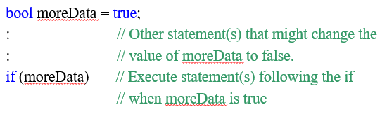
Boolean Results and Bool Data Types
Introduction
Boolean flags
Declare Boolean variable
bool identifier;
Initialize to true or false
Use to determine which statement(s) to perform
Example

Slide 7
Conditional Expressions
Introduction
Appear inside parentheses
Expression may be a simple Boolean identifier
if (moreData)
Two operands required when equality or relational symbols are used
Equality operator – two equal symbols (==)
Inequality operator – NOT equal (!=)
Relational operator – (<, >, <=, >=)

Slide 8
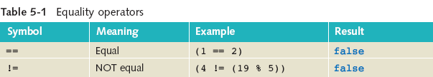
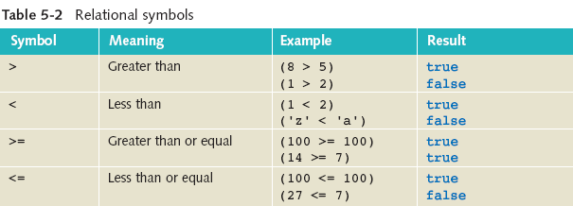
Equality and Relational Operators
Introduction

Slide 9
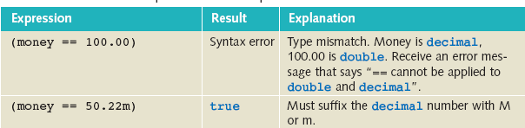
Conditional Expression Examples
Introduction
int aValue = 100, bValue = 1000;
string sValue = “CS158”;
decimal money = 50.22m;
double dValue = 50.22;

Slide 10
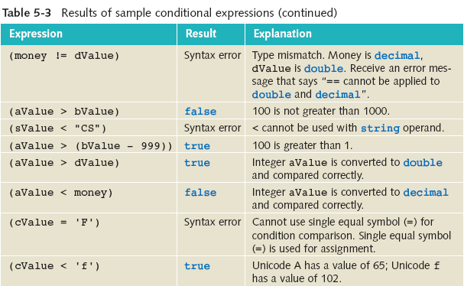
Conditional Expression Examples
Introduction
int aValue = 100, bValue = 1000;
string sValue = “CS158”;
decimal money = 50.22m;
double dValue = 50.22;
char cValue = ‘A’;

Slide 11
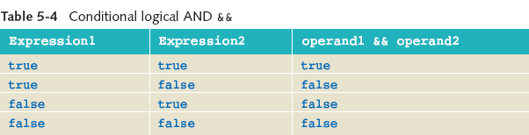
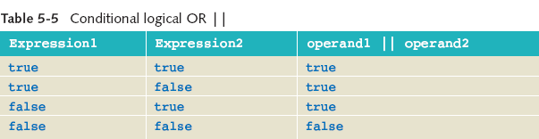
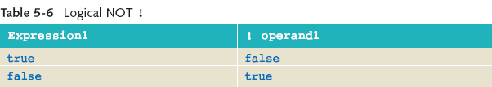
Logical Operators
Introduction

Slide 12
Short-Circuit Evaluation
Introduction
Short-circuiting logical operators
&& and ||
OR (||) expressions – if the first evaluates as true, no need to evaluate the second operand
AND (&&) expressions – if the first evaluates as false, no need to evaluate second operand
C# also includes the & and | operators
logical does not perform short-circuit evaluation

Slide 13
Selection Statement

Slide 14
if...else Selection Statements
Selection Statement
Classified as one-way, two-way, or nested
Alternate paths based on result of conditional expression
Expression must be enclosed in parentheses
Produce a Boolean result
One-way
When expression evaluates to false, statement following expression is skipped or bypassed
No special statement(s) is included for the false result

Slide 15
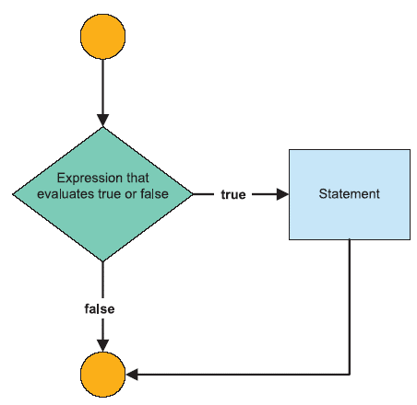
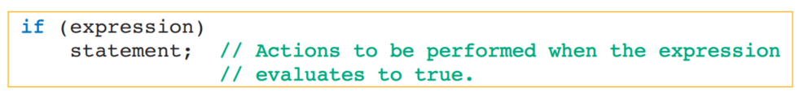
One-way Selection Statement
Selection Statement
No semicolon placed at end of expression
Null statement
Curly braces required with multiple statements
Syntax:

Slide 16
One-way Selection Statement – Sample Code
Selection Statement
A company issues $1000.00 bonuses at the end of the year to all employees who have sold over $500,000.00 in products. The following code segment is a program that allows users to enter their sales figure. It determines whether a bonus is due and displays a message indicating whether a bonus is awarded.

Slide 17
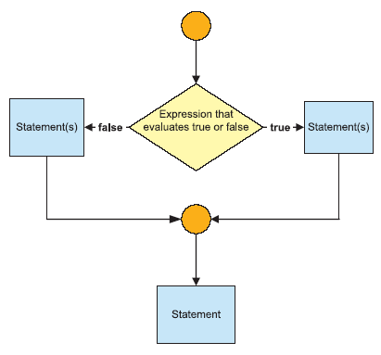
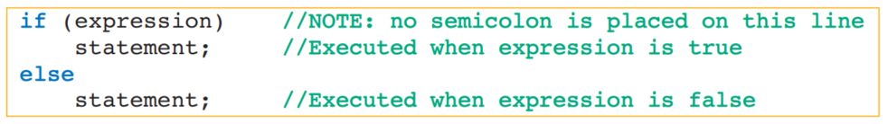
Two-way Selection Statement
Selection Statement
Either the true statement(s) executed or the false statement(s), but not both
No need to repeat expression else portion
Syntax:

Slide 18
Nested if…else Statement
Selection Statement
Acceptable to write an if within an if
When block is completed, all remaining conditional expressions are skipped or bypassed
Syntax for nested if…else follows that of two-way
Difference: With a nested if…else, the statement may be another if statement
No restrictions on the depth of nesting
Limitation comes in the form of whether you and others can read and follow your code

Slide 19
Nested if…else Statement – Sample Code
Selection Statement
Modify the BonusCalculator app to add the following requirements:
For hourlyEmployees working more than 40 hours, a bonus of $500 is issued. If hourlyEmployee has not worked more than 40 hours, issue a bonus of $100. For those non-hourlyEmployees, issue a $300 bonus if they have been employed longer than 10 years; otherwise, issue a $200 bonus.

Slide 20
Switch Selection Statements
Selection Statement
Considered a multiple selection structure
Also called case statement
Works for tests of equality only
Single variable or expression tested
Must evaluate to an integral or string value
Requires the break for any case
No fall-through available

Slide 21
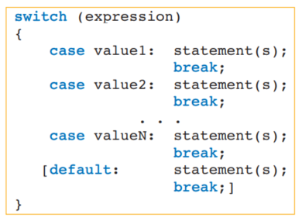
Switch Selection Statements General Form
Selection Statement
Selector
Value must be a of the same type as selector
Optional

Slide 22
Switch Statements
Selection Statement
Associate same executable with more than one case
Example (creates a logical OR)
case "AL":
case "aL":
case "Al":
case "al": Console.WriteLine(“Alabama”);
break;
Cannot test for a range of values

Slide 23
Switch Statements
Selection Statement
Case value must be a constant literal
Cannot be a variable
int score,
high = 90;
switch (score)
{
case high : // Syntax error. Case value must be a constant
// Can write “case 90:” but not “case high:”
Value must be a compatible type
char value enclosed in single quote
string value enclosed in double quotes

Slide 24
Switch Case Selection Statement – Sample Code
Selection Statement
Allows the user to enter a state/city abbreviation. A switch statement is used to display the full name of the state.
MNL – Manila
DVO – Davao
CEB – Cebu
MPH – Caticlan
USU – Busuanga
CDO – Cagayan de Oro

Slide 25
Repetition Statements

Slide 26
Why Use A Loop?
Repetition Statement
Repeat instructions with many data sets
Repetition or iteration structures
Rich set of looping structures
while
do…while
for
foreach statements

Slide 27
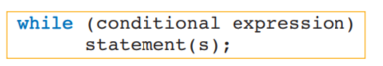
Using the while Statement
Repetition Statement
Simplest and most frequently used loop
The Conditional Expression – sometimes called loop condition
Returns a Boolean result of true or false
No semicolon after the conditional expression
Null body→ empty bodied loop→ infinite loop
Enclose multiple statements for body in { }
An interpretation of the while statement is “while condition is true, perform statement(s).”

Slide 28
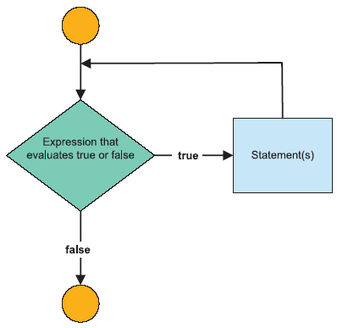
Using the while Statement
Repetition Statement
The while statement is a pretest loop, which means that the conditional expression is tested before any of the statements in the body of the loop are performed.
If the conditional expression evaluates to false, the statement(s) in the body of the loop is (are) never performed.
If the conditional expression evaluates to true, the statements are performed, and then control transfers back to the conditional expression.

Slide 29
Counter-Controlled Loop
Repetition Statement
When you know the number of times the statements must be executed, you can create a counter-controlled loop
With a counter-controlled loop, a variable simulating a counter is used as the loop control variable to keep track of the number of iterations
Initialized
Conditional expression designed so that you can exit the loop after a certain number of iterations
Increment counter with each iteration
Otherwise, infinite loop
Common problem
Off-by-one error
Loop body not executed for the last value OR
Loop body executed one too many times

Slide 30
Sentinel-Controlled Loop
Repetition Statement
Exact number of times loop body should execute not known
Often used for inputting data
Prime read on outside of loop
Also referred to as indefinite loops
Select a sentinel value
Extreme value or dummy value
Sentinel value used as operand in conditional expression
Tells user what value to type to end loop
Useful for loops that process data stored in a file
Sentinel is placed as last entry in file
Conditional expression must match selected sentinel value

Slide 31
State-Controlled Loops
Repetition Statement
Similar to sentinel-controlled loop
Referred to as flag-controlled loops
state-controlled loops stop when a certain state is reached
Can be Boolean variable (not a requirement)
Variable must be initialized
For each new iteration, evaluate to see when it changes state
Change its value inside the loop – to stop the loop

Slide 32
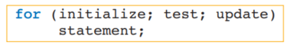
For Loop
Repetition Statement
Pretest form of loop (like the while)
Considered specialized form of while statement
Usually associated with counter-controlled types
Packages initialization, test, and update all on one line
General form is:
Interpreted as:

Slide 33
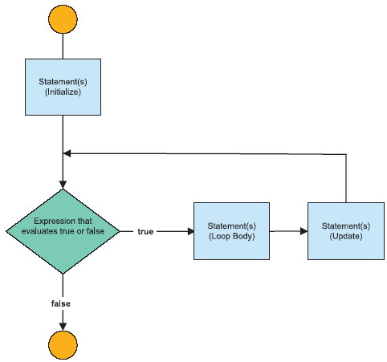
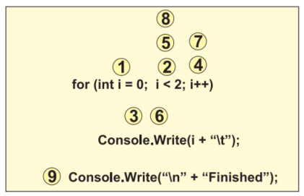
For Loop
Repetition Statement
For loop is executed as shown in the numbered steps

Slide 34
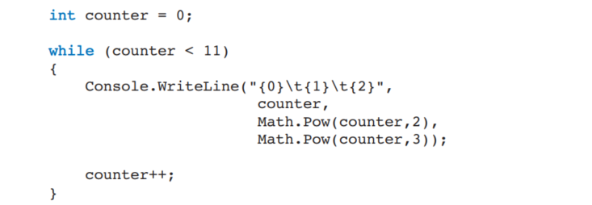
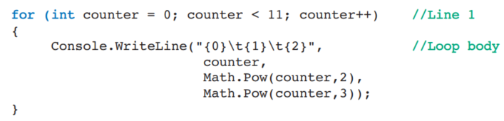
Comparison of While and For Statement
Repetition Statement
Replace above while loop with for loop below –does same

Slide 35
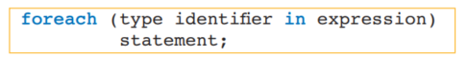
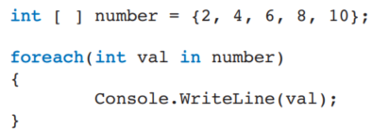
Foreach Statement
Repetition Statement
Used to iterate or move through a collection, such as an array
An array is a data structure that allows multiple values to be stored under a single identifier
General form is:

Slide 36
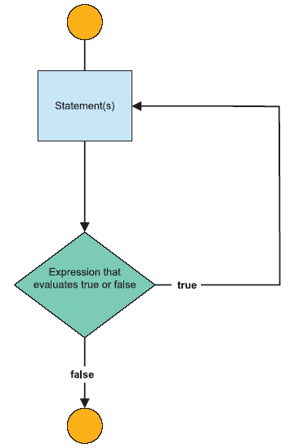
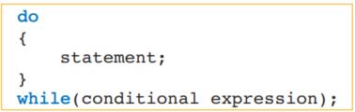
Do…While Statements
Repetition Statement
All of the loop structures you have learned up to this point are considered pretests.
The do...while is the only posttest loop structure available in C#.
General form is:

Slide 37
Deciding Which Loop to Use
Repetition Statement
Sometimes a personal choice
Body of the do…while always executed at least once
Posttest type
Numeric variable being changed by a consistent amount – for statement
While statement can be used to write any type of loop
Pretest type

Slide 38
Demo

Slide 39



Questions?

Slide 40
Thank you

